Slide 1
Infrastructure forward works pipeline update​
Owen Matthews,
Infrastructure Commission
Disclaimer - This presentation contains general information and is not formal advice. It is recommended that you seek independent advice on any matter relating to the use of the information. We will not be liable for any loss or damage whatsoever arising from the use of the information.
October 2020

Slide 2
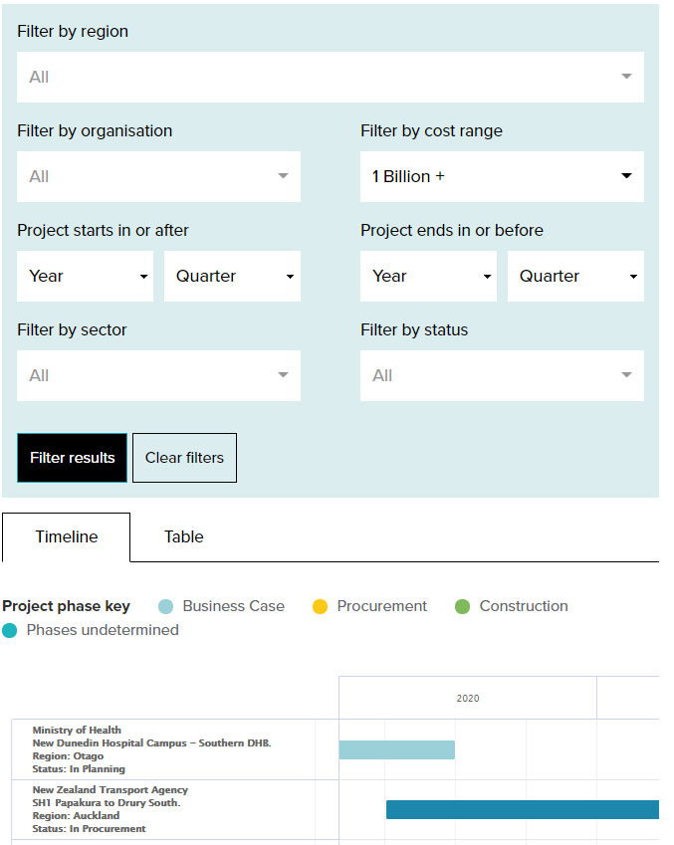
Infrastructure Forward Works Pipeline
Created due to the need for a more coordinated and certain pipeline of work
What, Where, and importantly When
Data sourced from organisations directly
Updated regularly
New filters have been added:
Funding Status (TBC, Confirmed etc)
Procurement type (open, panel etc)
Tags (NZUP, PGF etc)
https://infracom.govt.nz/projects/pipeline/
Notes:
The when is the important bit, most other pipelines rely on tracking announcements which rarely contain project timing, then infrequently updated after that.
Credible and committed versus visibility
Tags will include source of the project, NZUP, PGF, and IRG shovel ready when we get the data.

Slide 3
Benefits
For the Construction Industry:
Plan and invest in their business, informed by a confident view of upcoming projects
Early input into planned projects
Consistent workloads
For Contributors:
Enabling better planning of investment in New Zealand – smoothing the market, allowing for better utilisation of resources, capability and capacity
Access to information on other planned investments, building communication and improving coordination where possible
Driving market interest in projects prior to procurement, encouraging direct communication between agencies and market participants
Contractors willing and able to bid for new projects with more innovative options
Page 3

Slide 4
Linkage to the 30 year Strategy
The strategy will provide the public, various sectors, and government with a national set of recommendations and priorities for New Zealand’s infrastructure.
A first step in developing the strategy is understanding the current state of infrastructure in New Zealand, along with expected future trends and scenarios.
The pipeline and current state can be used in tandem to understand whether asset owners are planning to invest in areas where the needs assessment shows they are deficient.
The pipeline can become more certain and credible over time as the market, local govt, central govt etc engage in the development of the strategy and commit to an agreed path forward i.e. the pipeline is just a reflection of what has been committed to earlier.
30yr Strategy
Organisation Strategy
Asset Management Strategy
Investment Portfolio Prioritisation
Infrastructure Pipeline
Page 4
Notes:
In addition the political certainty from having published projects – incentive not to change tack when there is an agreed path.

Slide 5
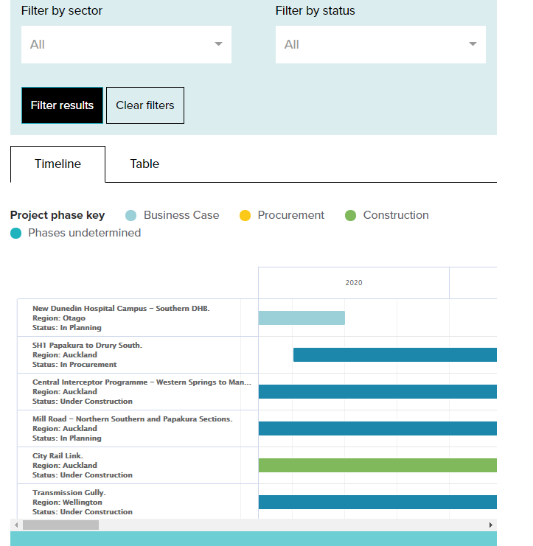
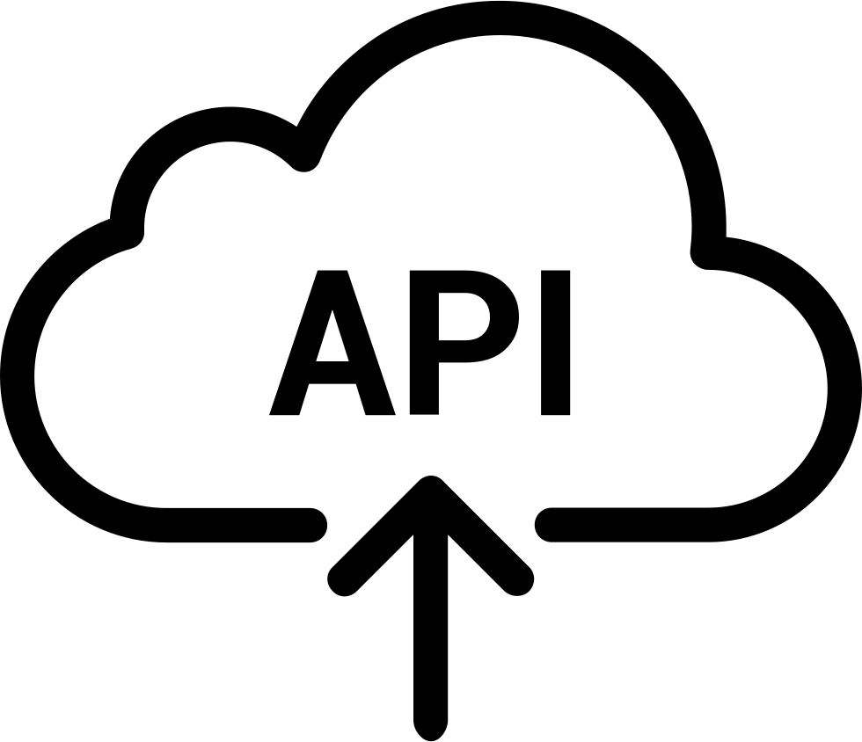
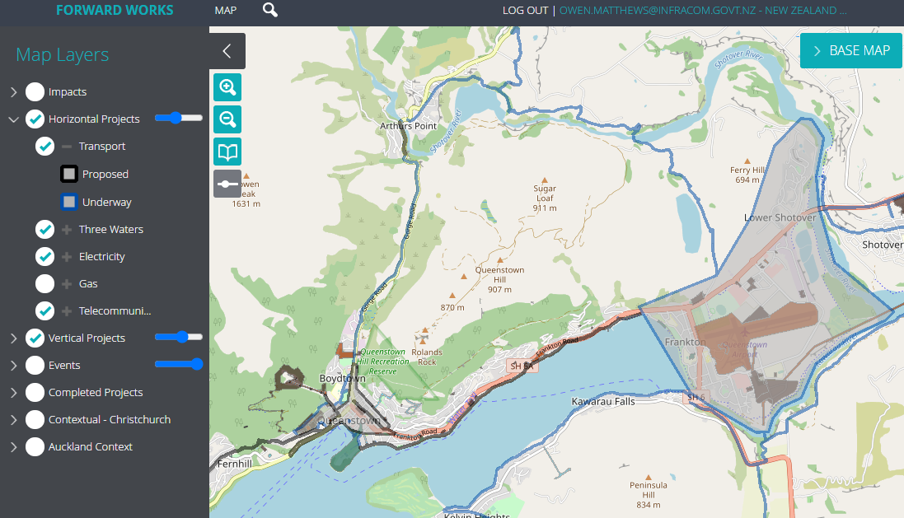
Project Data Pipeline process – future state
Input project Data
Collaborate
Publish to Market
Contributors
National Forward Works Viewer
Te Waihanga/Infracom Pipeline
NFWV includes a data discovery and helpdesk support to assist contributors to get their data into the viewer via manual input or API connections.
Additional data layers can be added such as events, asset data, any other spatial contextual data - building consents, over height bridges, redzone etc.
www.forwardworks.co.nz
Projects from central and local govt as well as private sector.
Once the projects are collaboratively agreed, they can be flagged in the viewer and then published to the market.

Slide 6
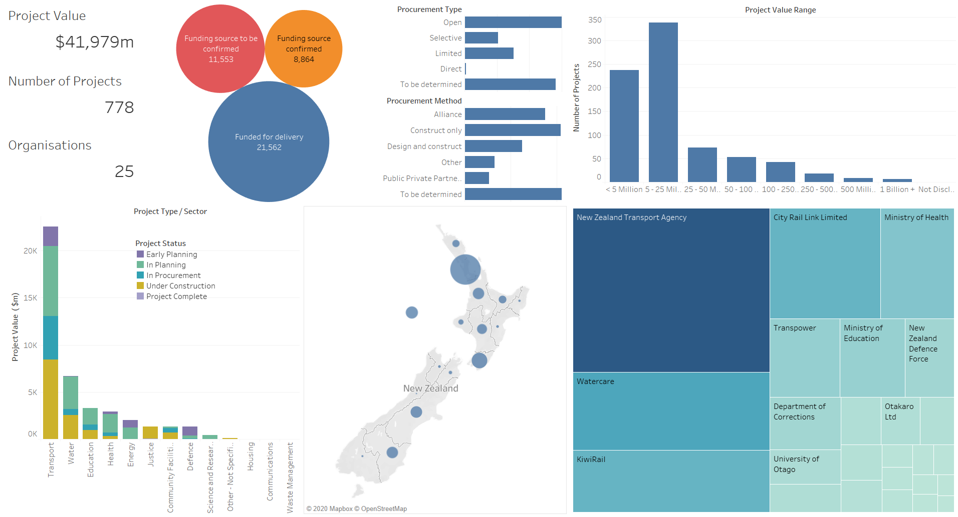
Current overview
Notes:
Aim is to make this interactive view available on the website.
Still a focus growing contributors – Ak council/AT should be back soon, and then more councils now that they are finalising annual plans (recognising LTPs next year.)

Slide 7
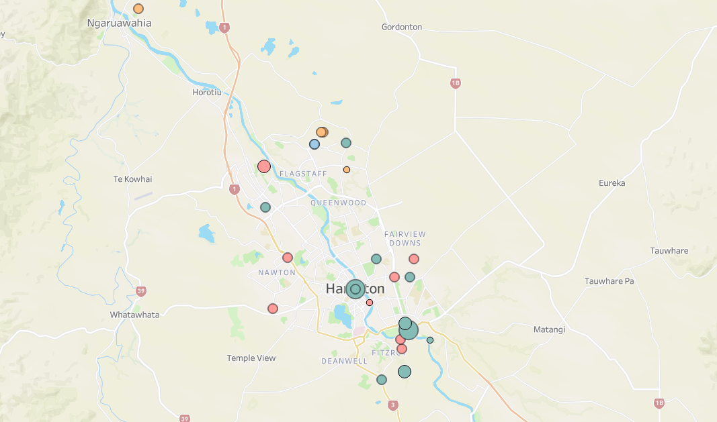
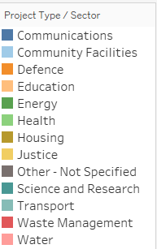
Notes:
Transport and water projects are the top two – same as the national pipeline.

